Slide 1
Getting People on Your Side
By Stan and Aissan

Slide 2
What is a Leader?
Leader
Charisma
Vision
Voice
Enthusiasm
Trust

Slide 3
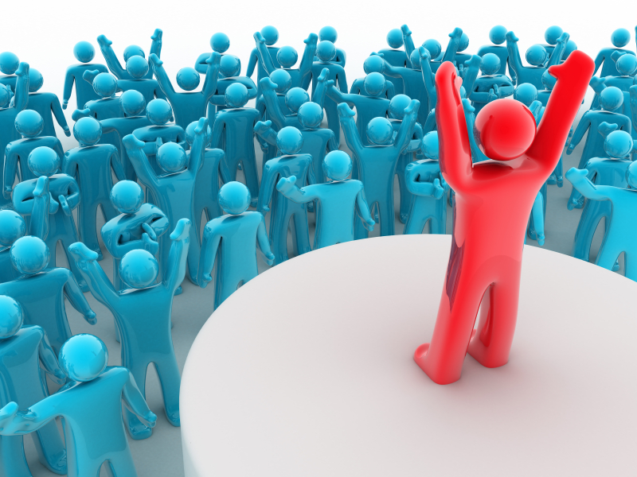
Voice
Inspiration, not orders
Power of persuasion
Team Speaking/Decision making
Open at all times/Up-front
CANNOT LEAD, IF NOONE FOLLOWS
The ability to speak!!!

Slide 4
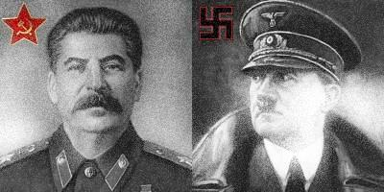
Leadership isn't always right
Lead with:
-Fear
-Intimidation
-Dependence
-Guilt

Slide 5
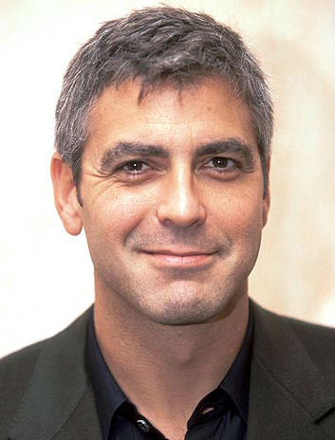
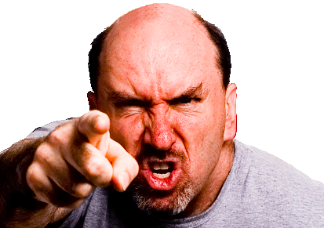
Charisma
A special magnetic charm or appeal
What???
Who would you rather follow, George or Angry Dude?

Slide 6
Enthusiasm
- Great excitement for an interest in a subject or cause
Positive outlook in work and life
Focusing on what can be done rather than on what cannot
Show that challenge is welcome
Enthusiasm is contagious

Slide 7
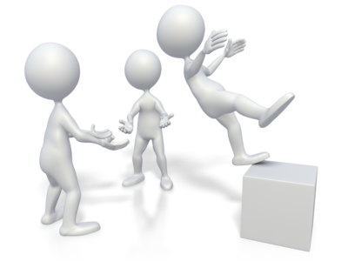
Trust
Reliance on the character, ability, strength, or truth of someone or something
4 main characteristics to gain trust one must have:
We got you! Don’t worry
- Constancy
- Congruity
- Reliability
- Integrity

Slide 8
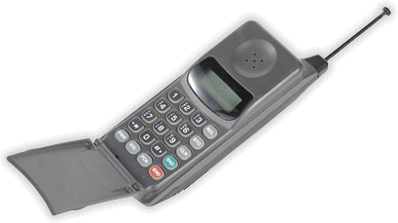
Vision
- The ability to think about or plan the future with imagination or wisdom
Guidance
Details
Innovative
Driven
Not 1-sided
Dedicated

Slide 9
How not to lead
So, If you get a opportunity to lead,
don’t do this ☺

Slide 10
THANK YOU ALL

